Slide 1

COST
Probability and Random Variables

Slide 2
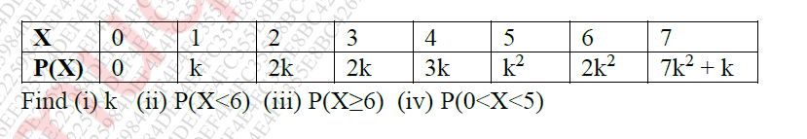
MU Nov18
A random variable X has the following probability distribution values of X

Slide 3


Solution-
$$\sum{P\left(X\right)}=1$$
0 + k + 2k + 2K + 3k + $k^{2}+$ ${2k}^{2}+{(7k}^{2}+k$) = 1
9k + 10 $k^{2}=1$
$${10k}^{2}+9k −1=0$$
$${10k}^{2}+10k −k −1=0$$
$$10k\left(k+1\right)−\left(k+1\right)=0$$
$$(10k−1)\left(k+1\right)=0$$
k = $\frac{1}{10 } or k$ = -1
Probability cannot be negative
Hence, k= $\frac{1}{10 }$= 0.1

Slide 4

Solution-
$P(X<6)$ = P(0) + P(1) + P(2) + P(3) + P(4) + P(5)
= $k^{2}+8k$
= 0.81
$P(X≥6)$ = P(6) + p(7)
= ${9k}^{2}+k$
= 0.19
$P\left(0<X<5\right)=P\left(1\right)+P\left(2\right)+P\left(3\right)+P\left(4\right)$
= 8k
=0.8

Slide 5

Practice Question
Find P(8<X<20), P(X >=20) , E(X), $E \left(X^{2}\right)$, V(X) and std. deviation for the probability distribution given below.
X | 8 | 12 | 16 | 20 | 24
P(X) | 1/8 | 1/6 | 3/8 | 1/4 | 1/12

Slide 6
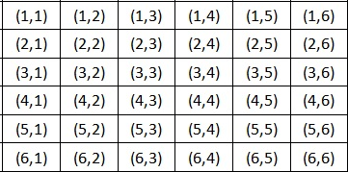
April 2019
A pair of fair dice is tossed and let X denote the sum of the points obtained. Find probability Distribution of X. Also find Expectation of X.
S =
X = {2, 3, 4, 5, 6, 7, 8, 9, 10, 11, 12}

Slide 7
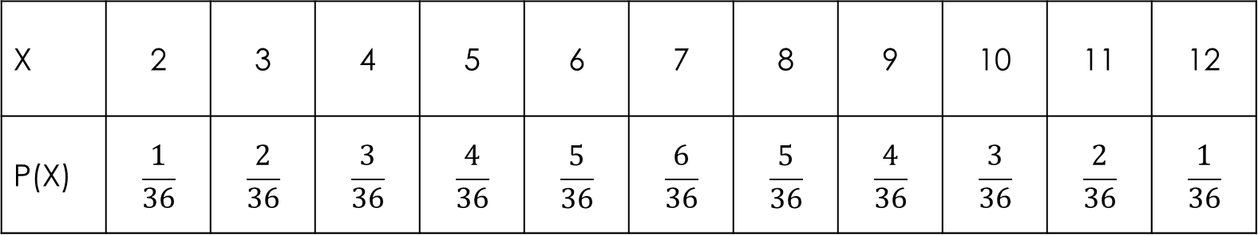

Cont..
PDF
E(X) = $\sum{x P\left(x\right)}$ =
X | 2 | 3 | 4 | 5 | 6 | 7 | 8 | 9 | 10 | 11 | 12
P(X) | $$\frac{1}{36}$$ | $$\frac{2}{36}$$ | $$\frac{3}{36}$$ | $$\frac{4}{36}$$ | $$\frac{5}{36}$$ | $$\frac{6}{36}$$ | $$\frac{5}{36}$$ | $$\frac{4}{36}$$ | $$\frac{3}{36}$$ | $$\frac{2}{36}$$ | $$\frac{1}{36}$$

Slide 8
Question
Three marbles are drawn without replacement from an urn containing 4 red and 6 white marbles. If X is a random variable that denotes the total number of red marbles drawn, (a) construct a table showing the probability distribution of X (b) Also find expected value of X.

